Slide 1
AutoPGN: Automating Chess Move Notation
Kevin Fu and Kevin Chung
Notes:
Title

Slide 2
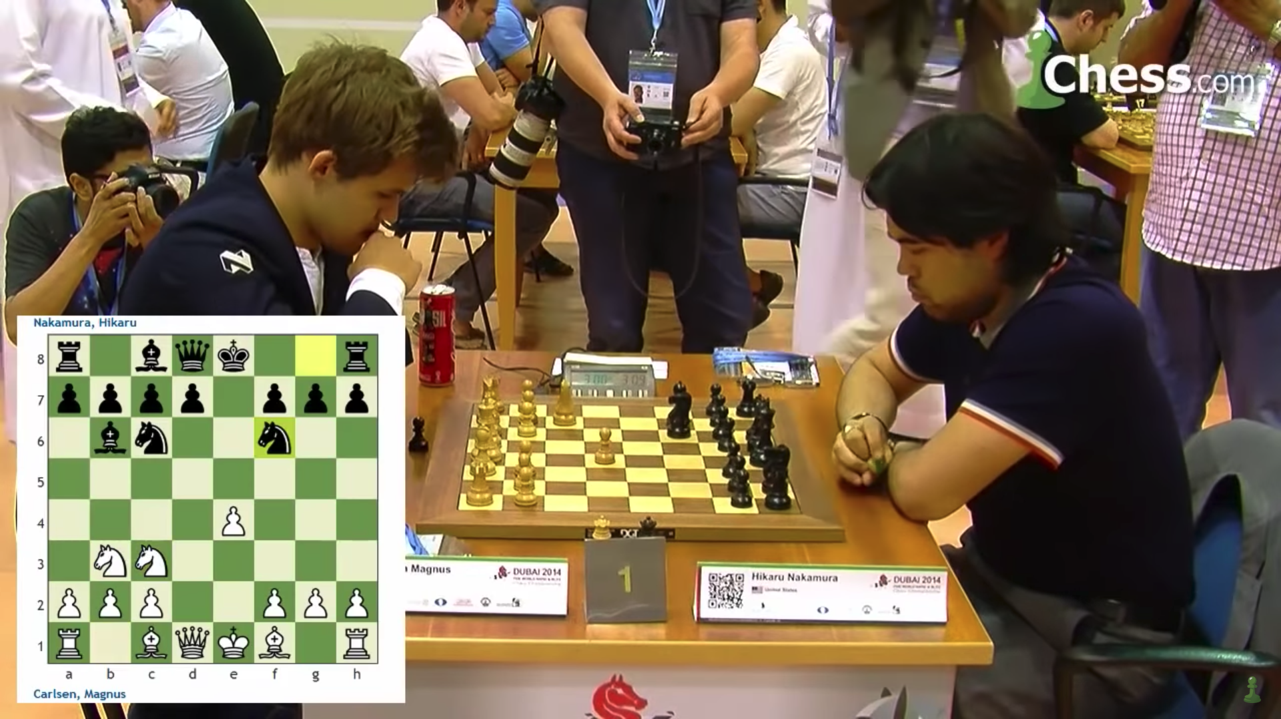
Problem
Notes:
Problem

Slide 3
Problem
Notes:
Problem 2

Slide 4
Problem
Notes:
Problem 3

Slide 5
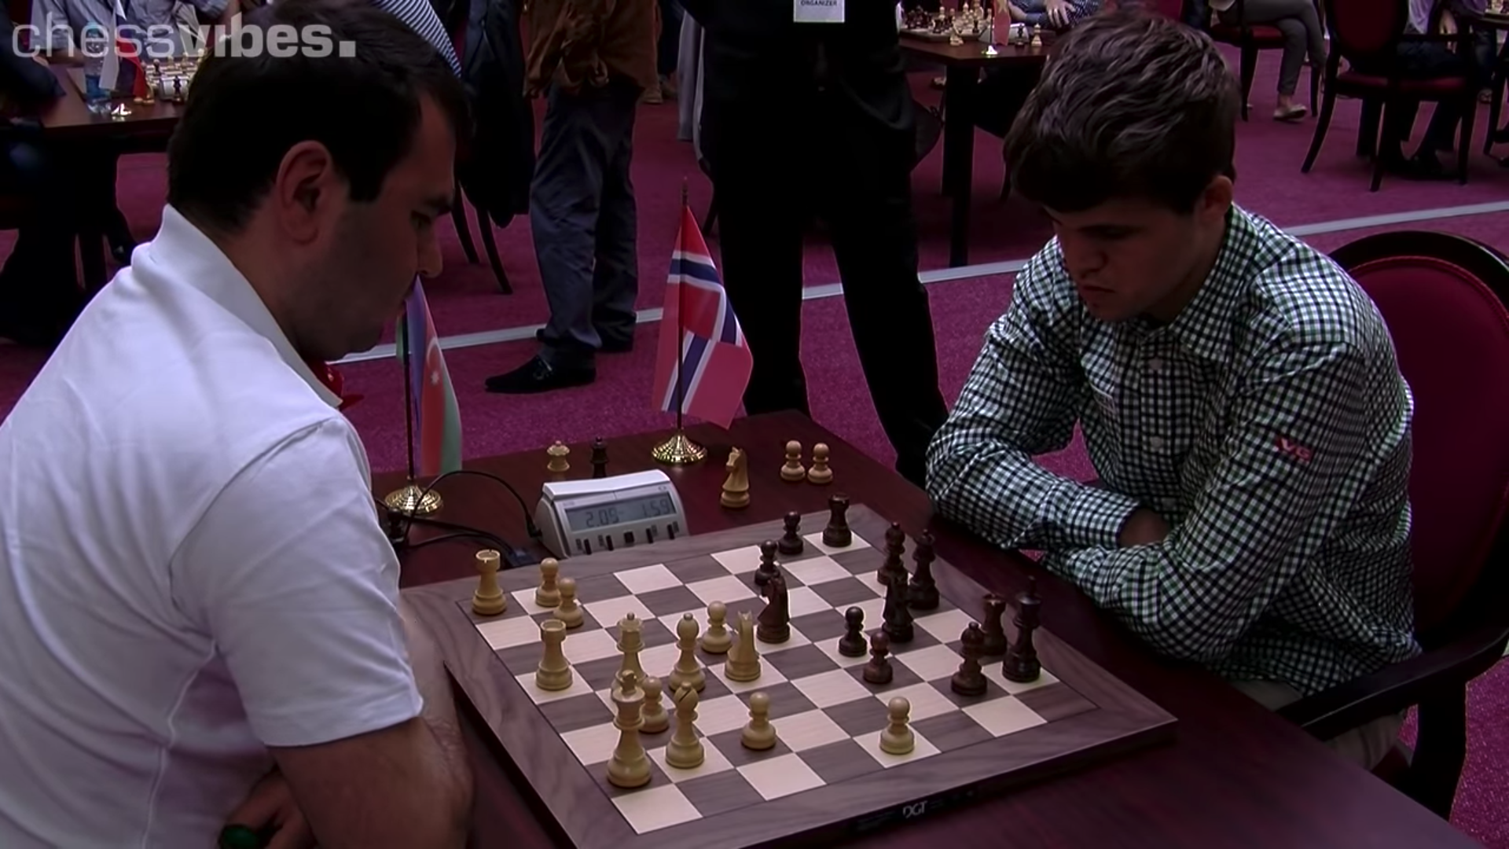
Notes:
Problem 4

Slide 6
Notes:
Problem 4

Slide 7
Proposal
By combining board detection with piece recognition, we can automate chess game notation.

Slide 8
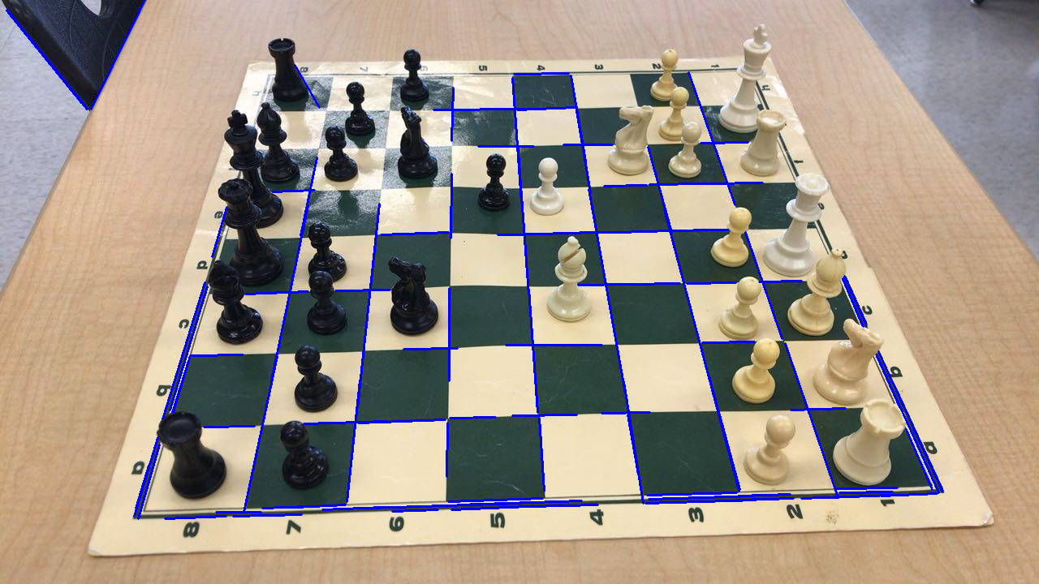
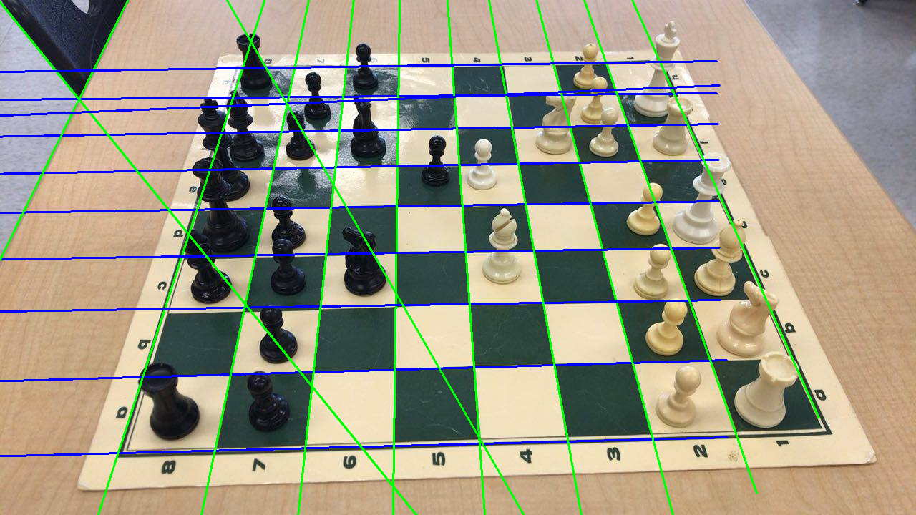
Line Detection
Contrast Limited Adaptive Histogram Equalization (CLAHE)
Probabilistic Hough Transform
Line Linking (Czyzewski, et al.)

Slide 9
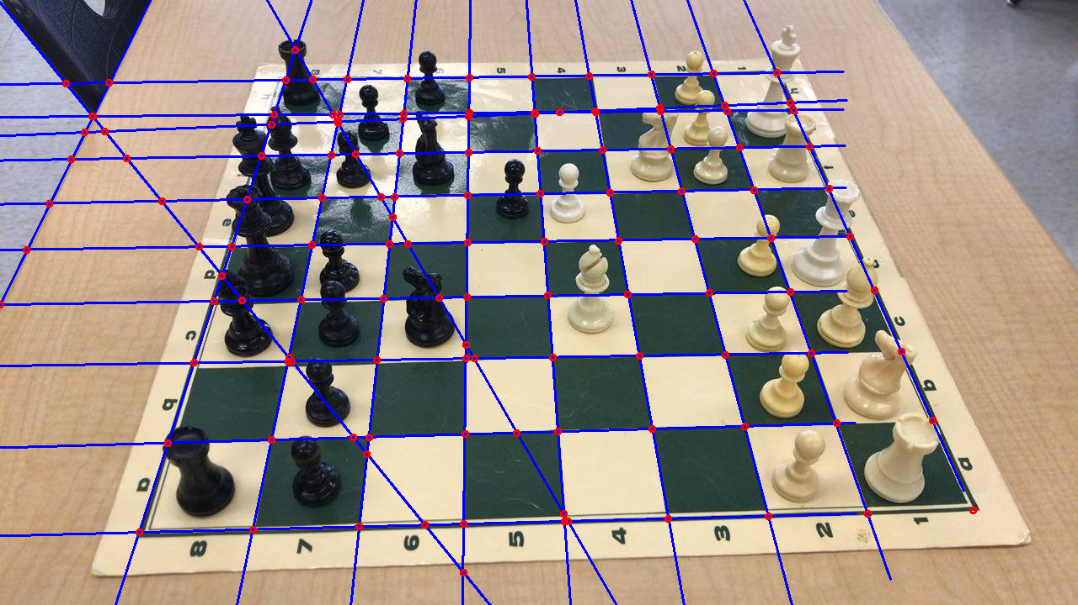
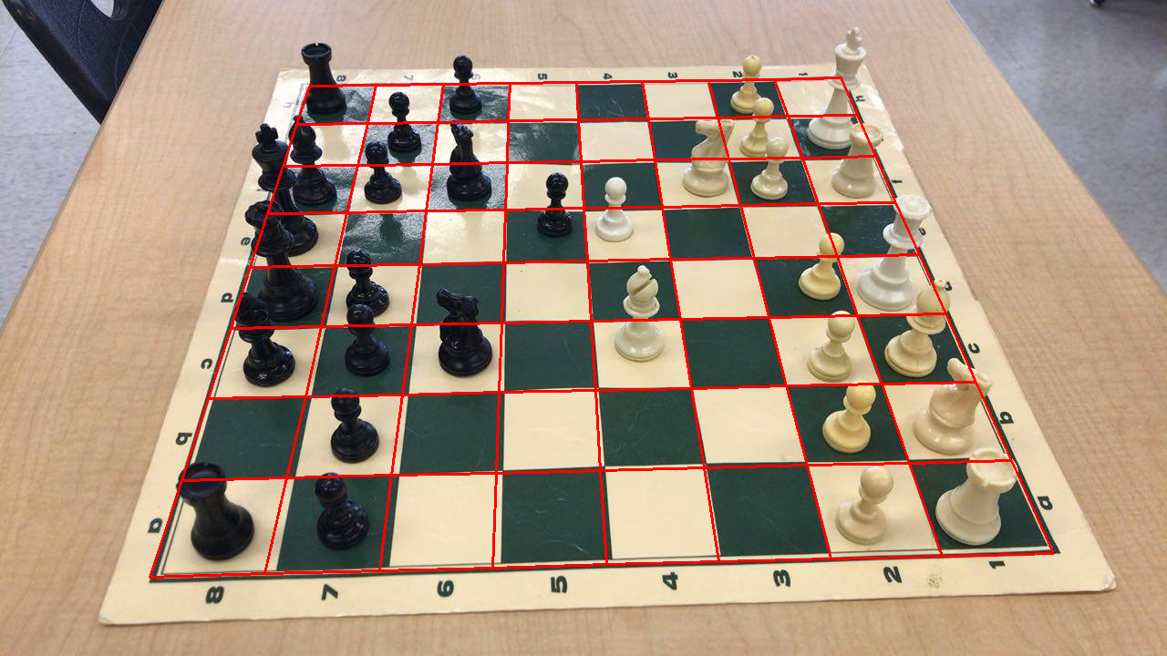
Board Detection

